Slide 1
Implementing Medicaid Behavioral Health Reform in New York
June 2015

Slide 2
Agenda
Purpose of BH MC Transition
Behavioral Health Managed Care Timeline Update
Plan Designation Status
State Plan and HCBS Services
HCBS Designation Status
Provider Technical Assistance
Consumer Outreach
Next Steps

Slide 3
Medicaid Redesign Team: Objectives
Fundamental restructuring of the Medicaid program to achieve:
Measurable improvement in health outcomes
Sustainable cost control
More efficient administrative structure
Support better integration of care

Slide 4
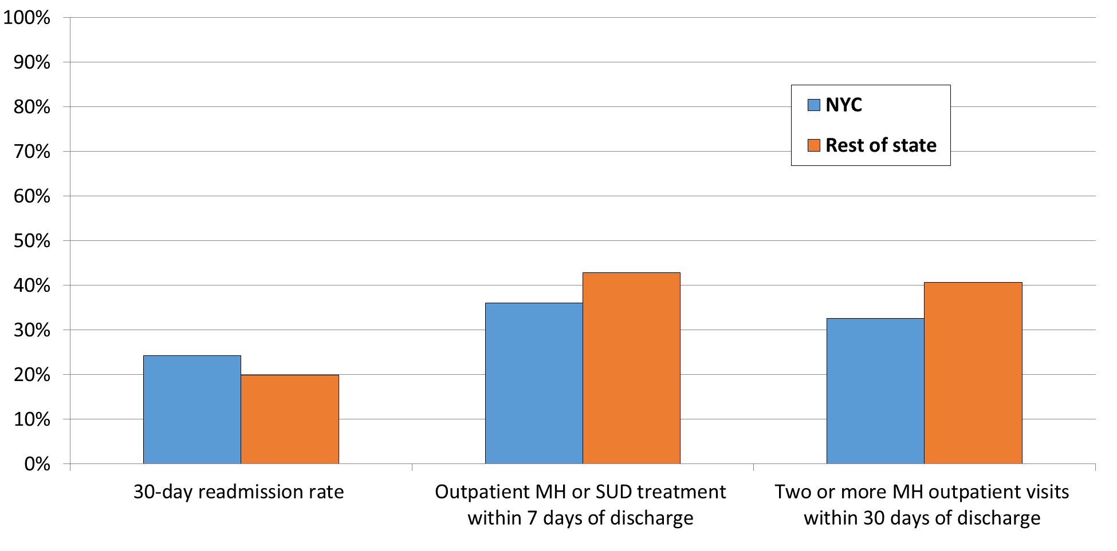
Why we need to transform care:

Slide 5
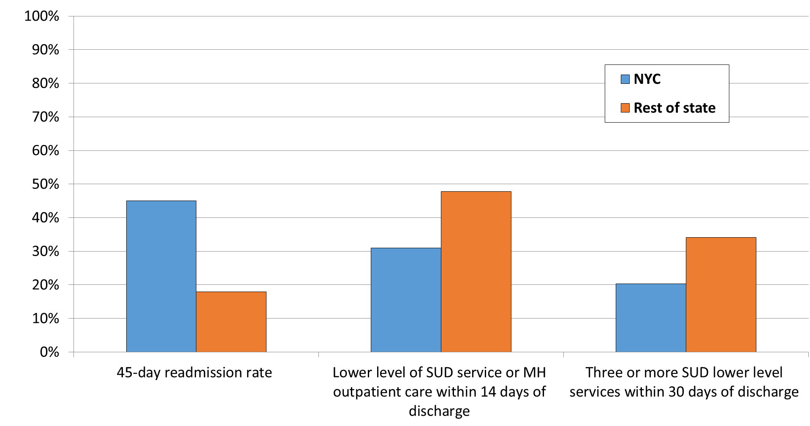
Why we need to transform care:

Slide 6
Integrated Care: In BHO Phase I, how often did behavioral health inpatient providers identify general medical conditions requiring follow-up, and did they arrange aftercare appointments?
Based upon 56,167 statewide behavioral health community discharges (all service types)
January 2012—June 2013

Slide 7
Principles of BH Benefit Design
Person-Centered Care management
Integration of physical and behavioral health services
Recovery oriented services
Patient/Consumer Choice
Ensure adequate and comprehensive networks
Tie payment to outcomes
Track physical and behavioral health spending separately
Reinvest savings to improve services for BH populations
Address the unique needs of children, families & older adults

Slide 8
Behavioral Health Managed Care Design
Behavioral Health will be managed by:
Qualified health Plans meeting rigorous standards (perhaps in partnership with a BHO)
All Plans MUST qualify to manage currently carved out behavioral health services and populations
Plans can meet State standards internally or contract with a BHO to meet State standards
Health and Recovery Plans (HARPs) for individuals with significant behavioral health needs
Plans may choose to apply to be a HARP with expanded benefits

Slide 9
Mainstream Plan vs. HARP
Mainstream Managed Care Plan
Health and Recovery Plan
Medicaid Eligible
Benefit includes Medicaid State Plan covered services
Organized as Benefit within MCO
Management coordinated with physical health benefit management
Performance metrics specific to BH
BH medical loss
Specialized integrated product line for people with significant behavioral health needs
Eligible based on utilization or functional impairment
Enhanced benefit package - All current PLUS access to HCBS
Specialized medical and social necessity/ utilization review for expanded recovery-oriented benefits
Benefit management built around higher need HARP patients
Enhanced care coordination - All in Health Homes
Performance metrics specific to higher need population and HCBS
Integrated medical loss ratio

Slide 10
NYC Managed Care Plan Qualification Process
Plans submitted applications June 2014
Final qualification pending successful completion of Readiness Review
Desk Audit (in progress)
On-Site Review (Schedule to begin 6/22/15-August)
Final Designation for HARPs to be awarded July 2015
Final Designation for Mainstream MCOs and HIV-SNPs to be awarded August 2015

Slide 11
Update on NYC Plan Designation
10 NYC MCOs responded to Behavioral Health RFQ
MetroPlus will provide three product lines (Mainstream/HARP/HIV-SNP)
Plans notified of conditional designation pending successful completion of readiness review
2 Mainstream MCO
6 HARPs
3 HIV-SNPs (with HARP-like benefits for HARP eligible members)
Approx. 85% of HARP eligible individuals in NYC in Plans with a HARP

Slide 12
Conditionally Designated Plans
Plan Name | Conditional Designation Status | Partnering with BHO
AFFINITY HEALTH PLAN INC | Mainstream | Beacon Health Options
AMERIGROUP NEW YORK LLC | Mainstream/ HARP | No
AMIDA CARE INC (HIV SNP) | Mainstream/ HIV-SNP | Beacon Health Options
HEALTH FIRST PHSP INC | Mainstream/ HARP | No
HLTH INSURANCE PLAN OF GTR NY (EMBLEM) | Mainstream/ HARP | Beacon Health Options
METROPLUS PARTNERSHIP CARE and HIV SNP | Mainstream/ HARP/ HIV-SNP | Beacon Health Options
NYS CATHOLIC HEALTH PLAN INC (FIDELIS CARE) | Mainstream/ HARP | No
UNITED HEALTHCARE OF NY INC | Mainstream/ HARP | Optum
VNS CHOICE SELECT HEALTH (HIV SNP) | Mainstream/ HIV-SNP | Beacon Health Options
WELLCARE OF NEW YORK INC | Mainstream | No

Slide 13
Adult Behavioral Health Managed Care Timeline- NYC Implementation
July 2015 – First Phase of HARP Enrollment Letters Distributed (see below for an explanation of initial enrollment process)
October 1, 2015 – Mainstream Plans and HARPs implement non-HCBS behavioral health services for enrolled members
October 2015-January 2016 – HARP enrollment phases in
January 1, 2016 – HCBS begin for HARP population

Slide 14
Adult Behavioral Health Managed Care Timeline- Rest of State Implementation
June 30, 2015 – RFQ distributed (with expedited application for NYC designated Plans)
MCOs submit ROS RFQ application- mid-September 2015
October 2015 – Conditional designation of Plans
October 2015-March 2016 – Plan Readiness Review Process
April 1, 2016 – First Phase of HARP Enrollment Letters Distributed
July 1, 2016 – Mainstream Plan Behavioral Health Management and Phased HARP Enrollment Begins

Slide 15
Children’s Health & Behavioral Health Managed Care Timeline
May 2015
Geographic Phase In
January 1, 2017 – NYC and Long Island Children's Transition to Managed Care
July 1, 2017 – Rest of State Children's Transition to Managed Care
Population Phase In for LOC/LON
Children will begin to enroll in Health Homes Designated to Serve Children on October 1, 2015.
OMH TCM providers and legacy clients will transition on October 1st as well.
The transition of care coordination services of the six 1915c children’s Waivers (OMH SED, DOH CAH I/II, OCFS B2H) to Health Home will also occur in 2017.

Slide 16
Status of Federal Approval
NYS has completed 1115 waiver amendment package
Waiver amendment
Budget Neutrality Calculations
Received Draft Special Terms and Conditions from CMS authorizing NYS to carve-in Behavioral Health services and create HARPs
NYS is working with CMS on a weekly basis to finalize the STCs

Slide 17
Behavioral Health State Plan Services-Adults
Inpatient - SUD and MH
Clinic – SUD and MH
Personalized Recovery Oriented Services (PROS)
Intensive Psychiatric Rehabilitation Treatment (IPRT)
Assertive Community Treatment (ACT)
Continuing Day Treatment
Partial Hospitalization
Comprehensive Psychiatric Emergency Program (CPEP)
Opioid treatment
Outpatient chemical dependence rehabilitation
Rehabilitation Services for Residents of Community Residences (Not in the benefit package in year 1)

Slide 18
Network Requirements
BH Network contracting requirements include:
Minimum of 24 months contracting requirements with OMH licensed programs or OASAS certified providers serving 5 or more Plan members
List of mandated providers has been distributed to Plans
Plans are required to submit monthly status updates demonstrating that they have contracted with mandated providers
All Products Clause
NYS will prohibit an all products contracting clause in the Medicaid managed care model contract for OMH licensed and OASAS certified programs.

Slide 19
New services added to BH 1115 waiver amendment (for OMH Mainstream and HARP populations)
Licensed Mental Health Practitioner Services
Allows for provision of community based (offsite) mental health services
Providers must operate within an clinic licensed by the Office of Mental Health (pursuant to 14NYCRR Part 599).
More information on program, staff, and rates will be forthcoming.
Behavioral Health Crisis Intervention
Moved from HCBS
Allows for off site crisis
NYS is developing program requirements

Slide 20
New services added to BH 1115 waiver amendment (for OASAS Mainstream and HARP populations)
Residential Redesign - Plans allowed to purchase medical/clinical services in OASAS residential programs
Three phases (captures OASAS Intensive Residential, Community Residential, Supportive Living and Medically Monitored Detox:
Stabilization – Introduction of medical/clinical staff. Individual will receive medically-directed care to treat acute problems and adjust early to recovery.
Rehabilitation – Individual will learn to manage recovery within the safety of the program.
Re-integration – Individual will further develop recovery skills and begin to re-integrate into the community.
Clinic to Rehab - Allows for provision of community based substance use disorder services

Slide 21
Home and Community Based Services – HARPs
Rehabilitation
Psychosocial Rehabilitation
Community Psychiatric Support and Treatment (CPST)
Habilitation
Respite
Short-Term Crisis Respite
Intensive Crisis Respite
Educational Support Services
Individual Employment Support Services
Prevocational
Transitional Employment Support
Intensive Supported Employment
On-going Supported Employment
Peer Supports
Support Services
Family Support and Training
Non- Medical Transportation
Self Directed Services Pilot

Slide 22
HARP HCBS Service Limits (Proposed Year 1)
The proposed limits consists of three elements:
Patient-specific Tier 1 limit of $8,000
Patient-specific overall HCBS (i.e., Tier 1 and Tier 2 combined) limit of $16,000
Short term crisis respite and intensive crisis respite are individually limited to 7 days per episode and 21 days per year.

Slide 23
HARP HCBS Service Limits (Proposed Year 1)
The Tier 1 and overall HCBS limits are exclusive of the crisis respite limits.
These limits may be exceeded with prior approval from either the OASAS Medical Director or OMH Managed Care Medical Director (Health and Wellness Exception).

Slide 24
HCBS Provider Designation
NYS has designated 172 providers in NYC
There will be a separate process for upstate HCBS providers
Anticipate Rest of State HCBS designation process will begin in May/June 2015
Designated providers need to comply with Medicaid compliance requirements (MCTAC training on this will roll out shortly)
Providers need to contract with Plans to get HCBS business

Slide 25
HCBS Provider Designation
State designation covers both OMH and OASAS HARP enrollees
HCBS applications and a list of designated providers are available at:
https://www.omh.ny.gov/omhweb/guidance/hcbs/html/services-application/
NYC Designated provider list shared with Plans
NYS HCBS rates can be found at: http://omh.ny.gov/omhweb/bho/harp-rate-codes.pdf
NYS HCBS provider oversight process under development

Slide 26
HARP Enrollment and Assessments

Slide 27
HARP Enrollment
All HARP eligible individuals identified by the state will be offered an opportunity to enroll into a HARP
HARP eligible members will only be passively enrolled in a HARP if they are enrolled in a Plan which offers a HARP
Individuals will not be passively moved to another Plan’s HARP
However, they may choose to enroll in a HARP
HARP eligible individuals enrolled in an HIV-SNP will be able to remain in their Plan and receive HARP benefits or switch to another HARP

Slide 28
HARP Enrollment
Ability to opt out of HARP or choose different Plan:
Individuals identified for passive enrollment will be contacted by the NYS Enrollment Broker.
They will be given 30 days to opt out or choose to enroll in another HARP
Once enrolled in a HARP, members will be given 90 days to choose another HARP or return to Mainstream before they are locked into the HARP for 9 additional months (after which they are free to change Plans at any time).
Individuals initially identified as HARP eligible who are enrolled in an MCO without a HARP will NOT be passively enrolled
They will be notified of their HARP eligibility and referred to the NYS Enrollment Broker to help them decide which Plan is right for them

Slide 29
Consumer Outreach and Provider Technical Assistance

Slide 30
Consumer Outreach
HARP enrollment notification letters scheduled for distribution July 2015-Septemeber 2015
Consumer education materials under development in partnership with community advocates and State partners
Fact Sheets
Information Flyers
Webinars
Forums in NYC are scheduled for Summer 2015
Additional outreach to be conducted for ROS beginning 2016

Slide 31
Provider Technical Assistance
NYS is funding the Managed Care Technical Assistance Center (www.mctac.org) to provide support and capacity building for providers:
Contracting
Business & Clinical Operations Innovation:
Home and Community Based Services:
Evaluating, measuring, & communicating:
Billing, Finance & Revenue Cycle
Utilization Management
MCTAC is developing dedicated HCBS provider trainings
HCBS services (with CPI)
Business Practices targeted at small providers

Slide 32
Provider Technical Assistance
Start-up Assistance for Designated HCBS Providers (up to two years)
Managed Care Behavioral Health - Health Information Technology (HIT)
NYS is developing a process to assist behavioral health providers who currently do not have the technological infrastructure to efficiently transition to a managed care system
Funding targeted first to agencies with little or no Medicaid or Medicaid Managed Care experience
HCBS provider start up grants
Providers will need to demonstrate a contractual relationship (or letters of intent) with HARPs
Funding targeted first to agencies with little or no Medicaid or Medicaid Managed Care experience
Notification of funding availability targeted for distribution in June

Slide 33
Next Steps
Complete Readiness Reviews
Monitor Provider Network Adequacy and Access to Services
Continue Managed Care Technical Assistance
Roll out Rest of State - Adult Behavioral Health Managed Care
Roll out Children’s Behavioral Health Managed Care

